Slide 1
ANZ Task 1 visualization
File created on: 10/03/2022 15:25:36

Slide 2
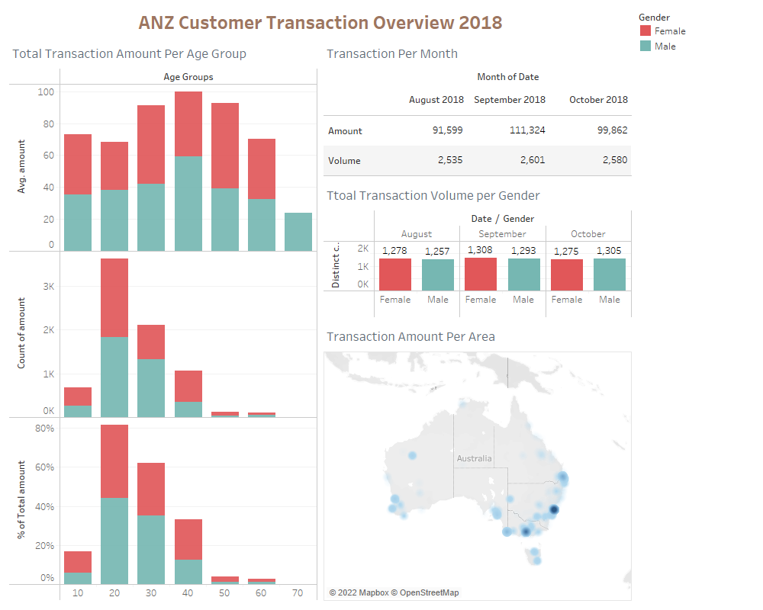

Slide 3
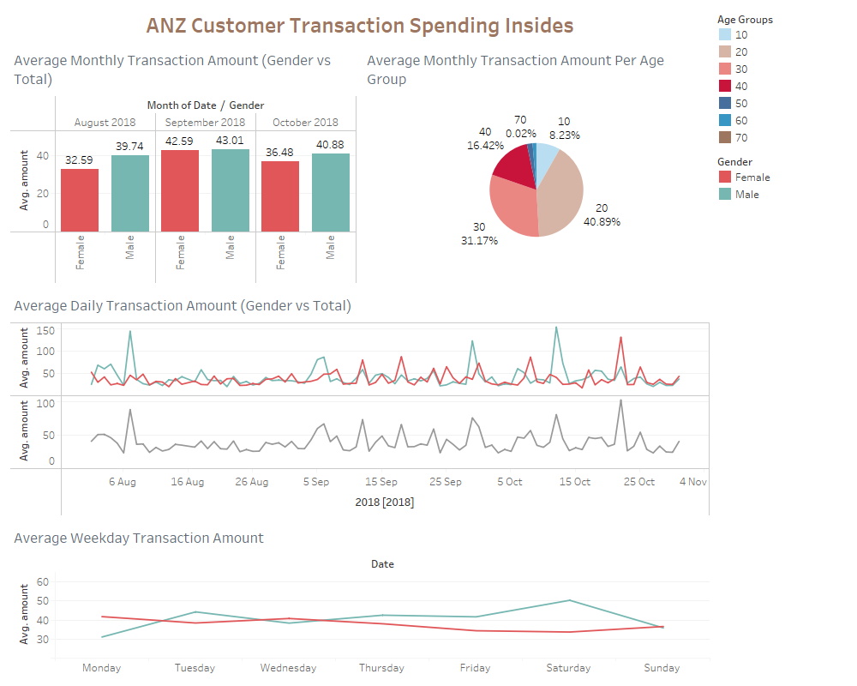

Slide 4
